Slide 1

Analysis of Average Farm Size by Country
DATA ANALYSIS PROJECT
Research Team :
COMPAORE Arielle,
KONDOMBO Ibrahim,
ZONGO Gilbert,
ZONGO Viviane
3
Reviewers: Miss Otema & Miss Blebo
1

Slide 2

Context and Justification
Average farm size serves as a crucial indicator for understanding agricultural evolution and assessing the effectiveness of agricultural policies worldwide.
Studying these data patterns enables researchers to identify emerging trends, evaluate cross-country differences, and inform evidence-based policy recommendations for sustainable agricultural development.
2

Slide 3


Research Question
Central Question
"How has average farm size evolved across different countries between 1960 and 2020?"
Growth Trends
Policy Impact
Identifies patterns of agricultural growth or decline across nations over six decades
Reveals the influence of agricultural policies and socio-economic factors on farm structure
3

Slide 4
Methodology
01
Data Cleaning
Removal of missing values, correction of data types, and elimination of duplicate entries to ensure data integrity
02
Exploratory Analysis
Calculation of descriptive statistics including mean, median, minimum, maximum, and standard deviation for comprehensive understanding
03
Indicator Creation
Development of annual variation metrics for average farm size to track temporal changes
04
Visualization
Generation of comparative histograms and evolution curves to illustrate trends clearly
4

Slide 5

Key Visualizations
The following graphs present the evolution of average farm size across different countries spanning the period from 1960 to 2020.
These visualizations reveal critical patterns in agricultural structure transformation and highlight the diverse trajectories of farm consolidation or fragmentation worldwide.
5

Slide 6
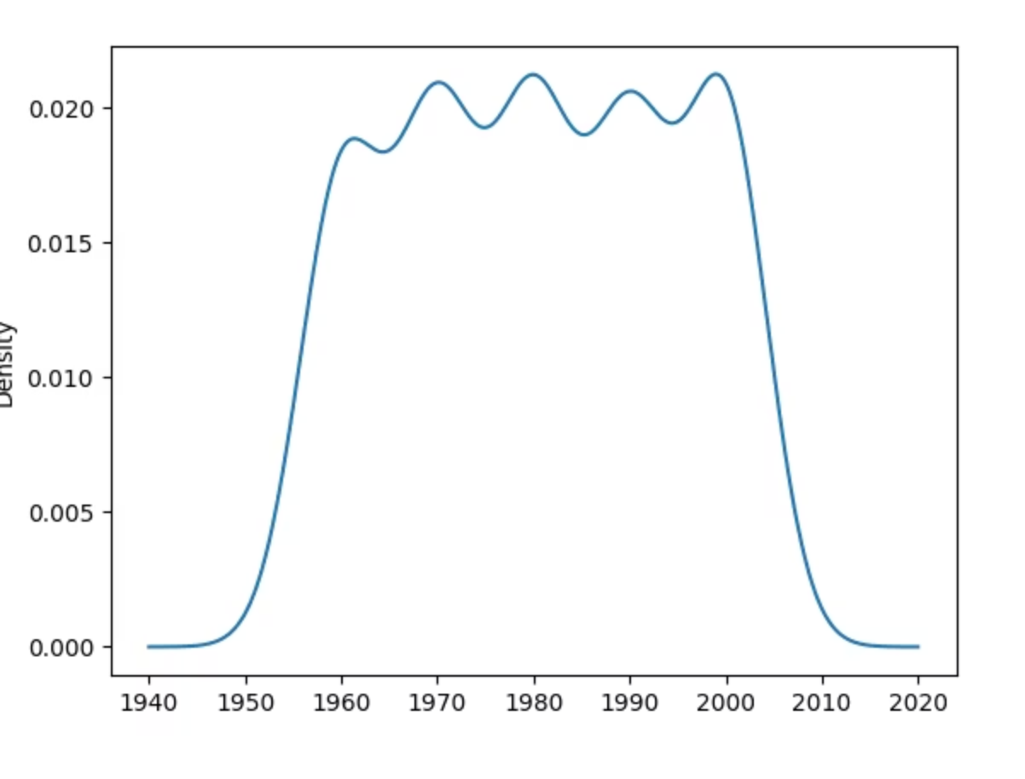
Farm Size Distribution Analysis
This histogram illustrates the distribution of average farm sizes across the analyzed countries, revealing significant variations in agricultural structure and land consolidation patterns.
6

Slide 7
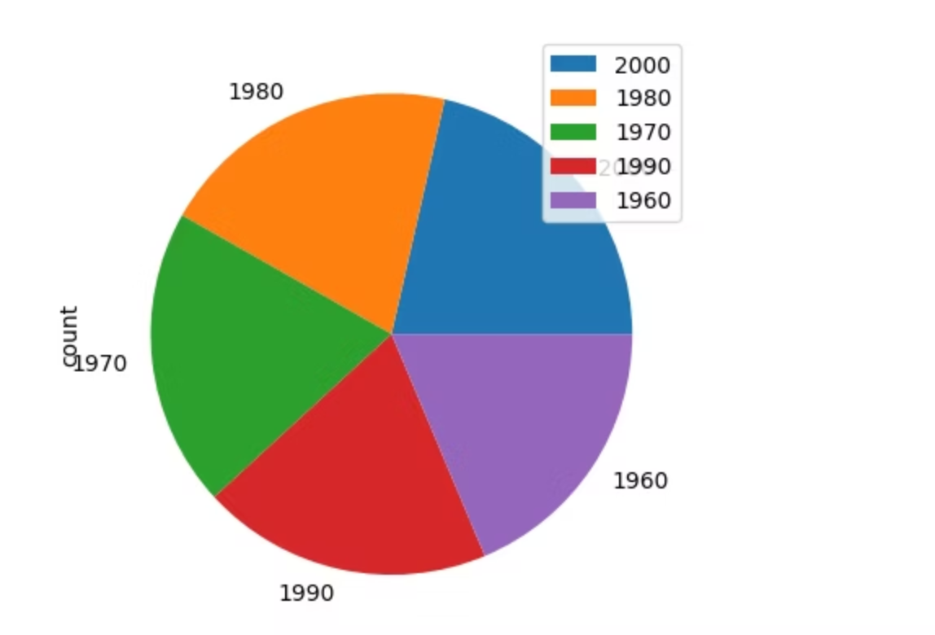
Comparative Country Analysis
Cross-country comparison reveals divergent paths in agricultural development, influenced by unique policy frameworks, economic conditions, and land tenure systems.
7

Slide 8
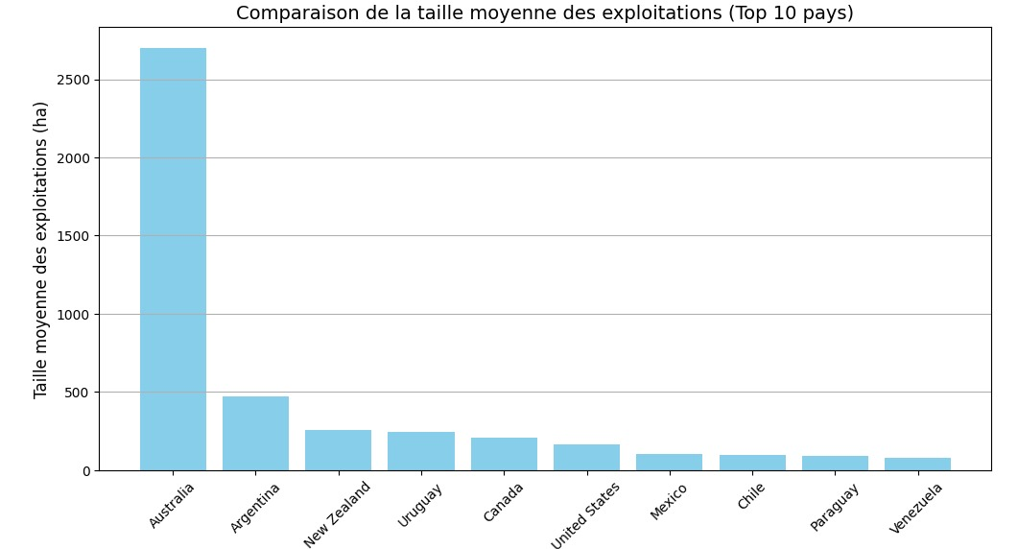
Regional Agricultural Landscapes
Visual representation of diverse agricultural landscapes reflects the physical manifestation of varying farm size policies and economic pressures across regions.
8

Slide 9



Results and Interpretation
Average farm size varies significantly across countries, revealing three distinct patterns of agricultural structural change over the 60-year period studied.
Continuous Growth
Countries like France demonstrate steady farm consolidation driven by mechanization and EU agricultural policies
Stagnation
Nations such as Spain show relative stability in farm size due to balanced policies and geographical constraints
Fragmentation
Some countries experience declining farm sizes due to inheritance practices and population pressure on agricultural land
These divergent trends reflect country-specific agricultural policies, land tenure systems, and socio-economic conditions that shape farm structure evolution.
9

Slide 10

References
SOURCES
USED TOOLS
Our World in Data
Python
World Bank
Pandas
NumPy
Matplotlib
METHODE : Exploratory analysis, variation indicators, visualizations
10

